Slide 1
Heart Attack prediction
Presented By Smriti Keshri for Mentorness
Under Batch MIP-ML-15
Date: 27/07/2024

Slide 2
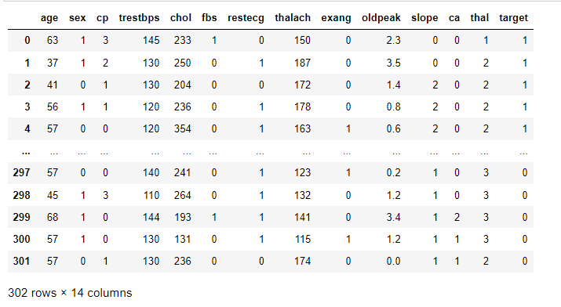
1. Load Dataset

Slide 3
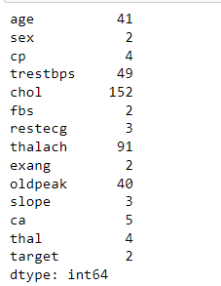
2. Data Preprocessing and Visualization
Finding number of unique values in all features/columns

Slide 4
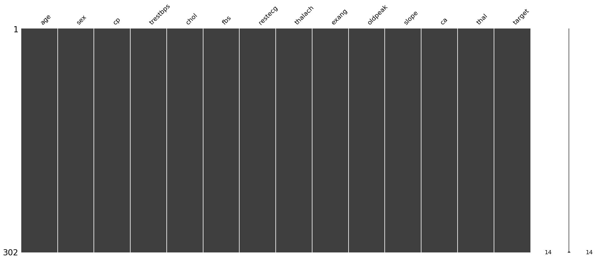
Visual representation of any null values present in the dataset

Slide 5
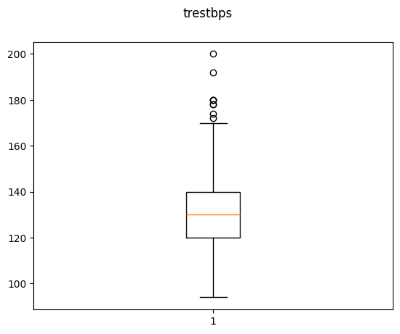
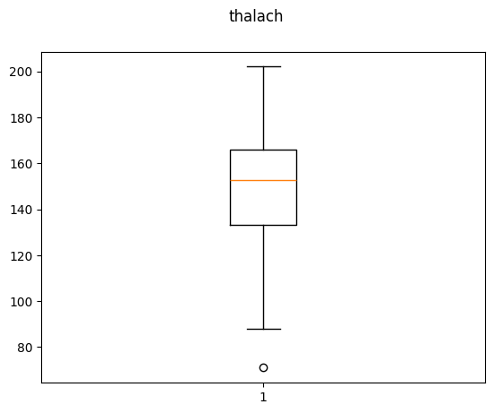
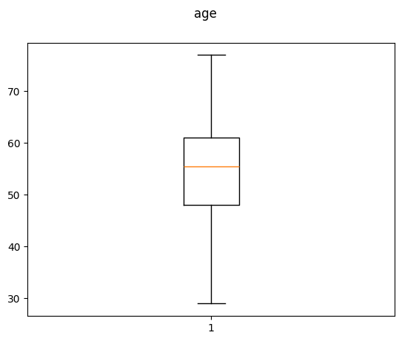
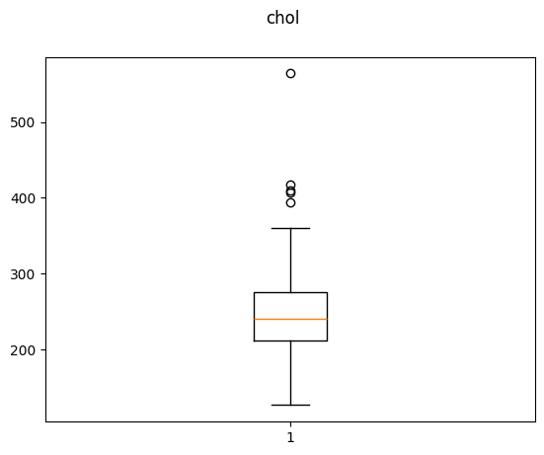
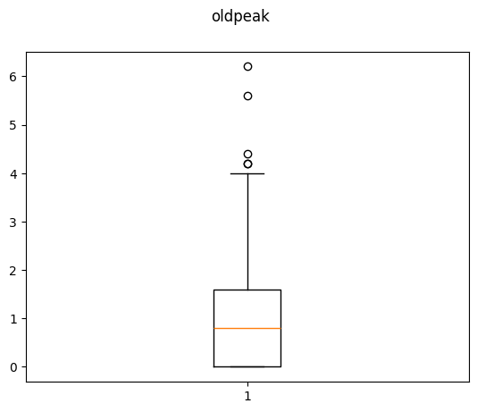
For discrete numbers finding outliers

Slide 6
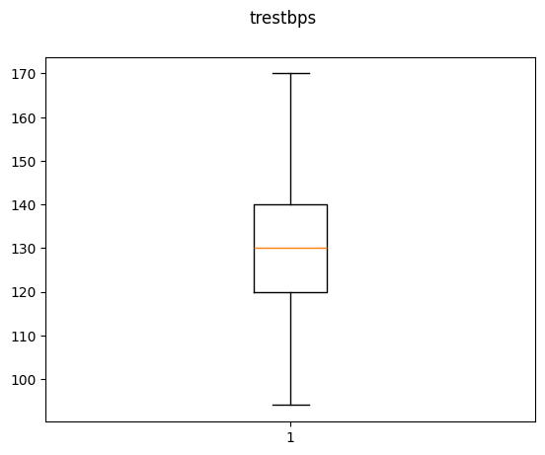
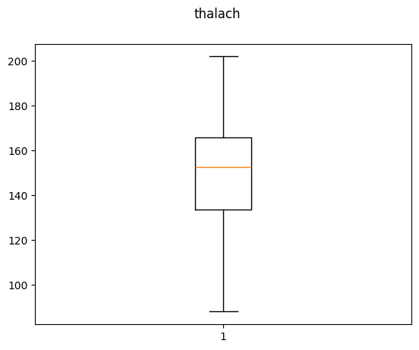
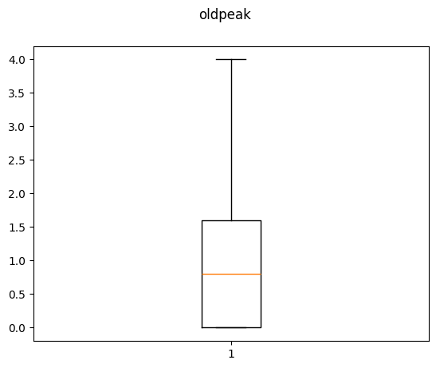
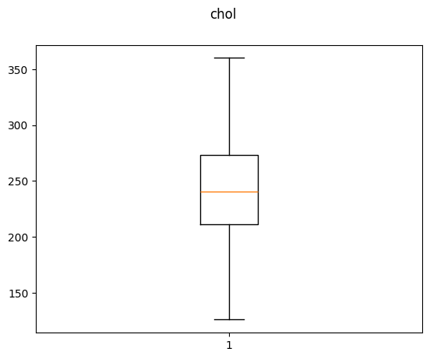
For some outliers removing row if outlier in chol is greater than 500 and thalach is less than 80
For some outliers replace with median

Slide 7
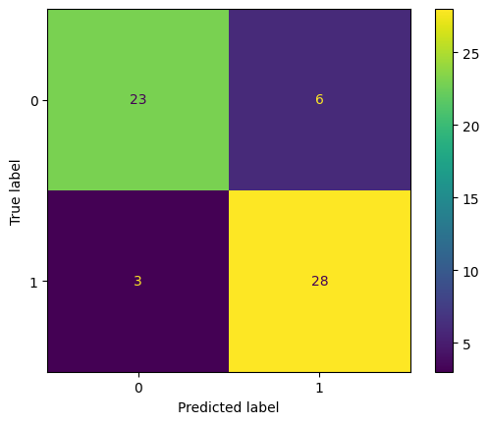
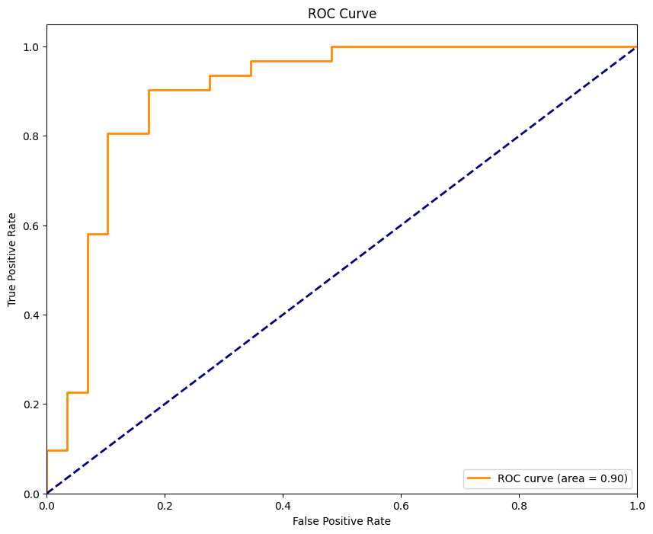
Random Forest Classification model
Training Accuracy : 0.9125
Testing Accuracy : 0.8500

Slide 8
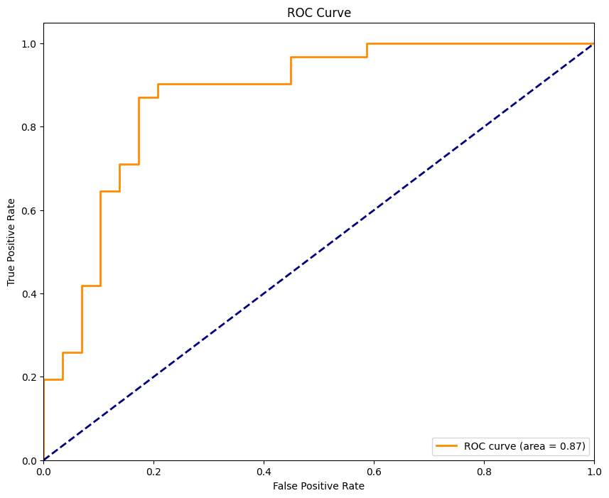
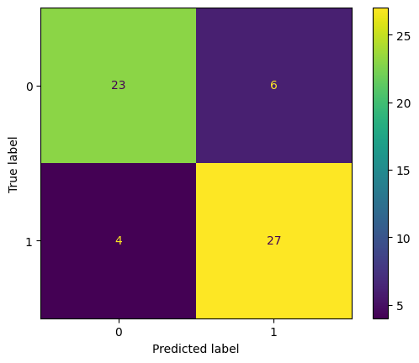
Logistic Regression Model
Training accuracy: 0.87083
Accuracy: 0.83333

Slide 9
Thank You

